Slide 1

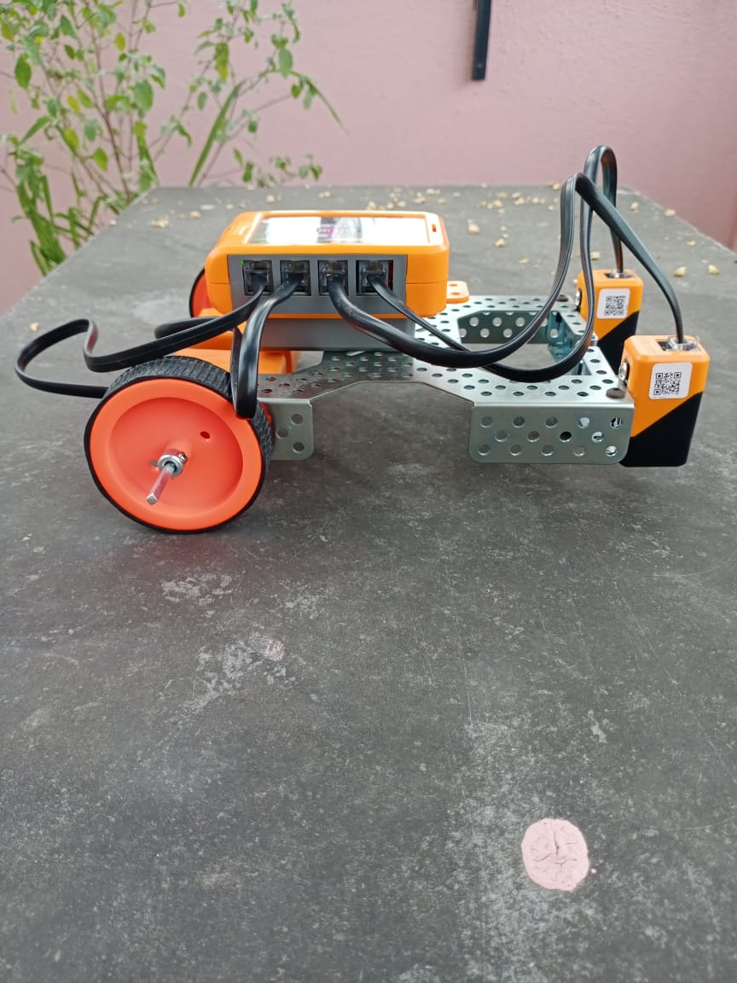

AUTOMATED LINE FOLLOWER ROBOT
Battle of Science

Slide 2
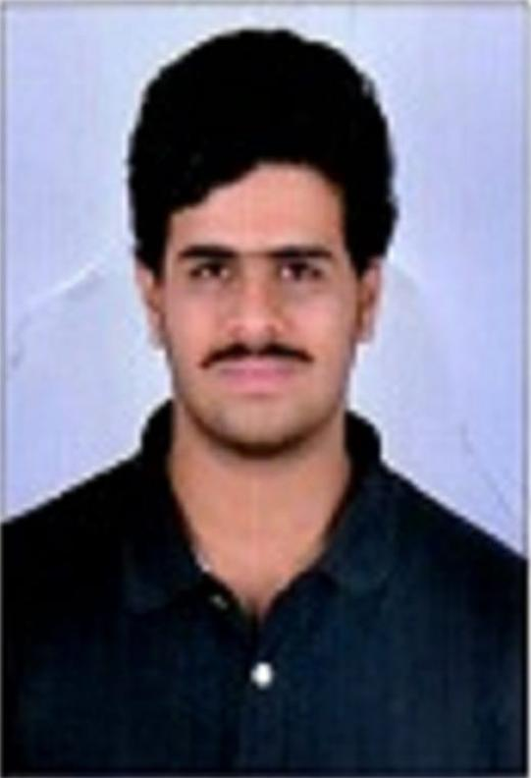

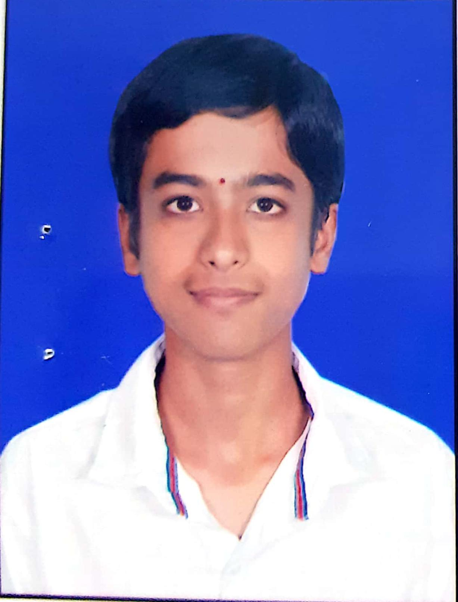


PRESENTING BY :
Nishchit YV
1CE21AI012
Dhanush NS
Vamshi Kashyap S
1CE21IS005
1CE21EC017
Tharun HS
Gagan DN
1CE21CS140
1CE21AI009

Slide 3

UNDER GUIDANCE OF :
Sir,
We may not say this everyday, but your inspirational Words, guidance, caring and support are the foot 👣 prints that have been etched In our hearts and mind forever.
Thank you sir, for wounder support and guidance.
We were really blessed to have a wonderful teacher like you.
Harsha Vardhan U
Assistant professor,
Dept. of M.E,
CEC, Bangalore

Slide 4
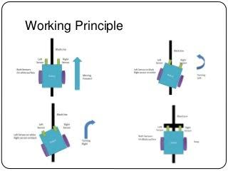
Working principle :
Transmitter and receiver sensors.
Signals receiving speed, frequency, signal intensity etc.
Every colour has different frequencies of reflection of light.

Slide 5
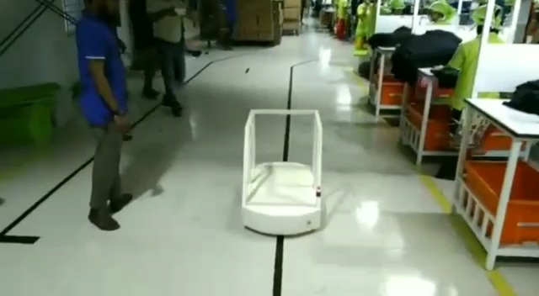
APPLICATIONS :
Industrial applications

Slide 6
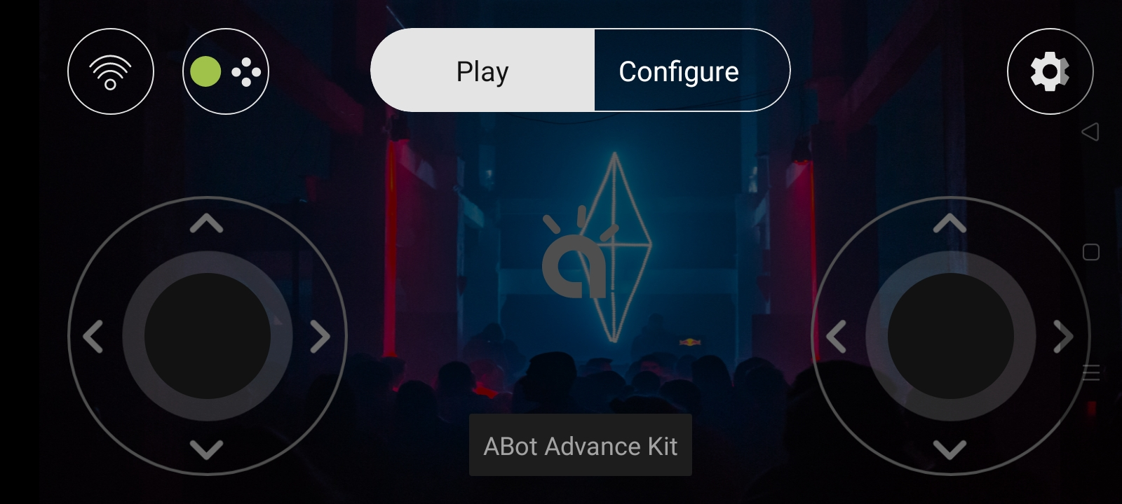
Manual countrol :
Mobile/Smart phone controls
Wifi connectivity
Easy countrolable

Slide 7
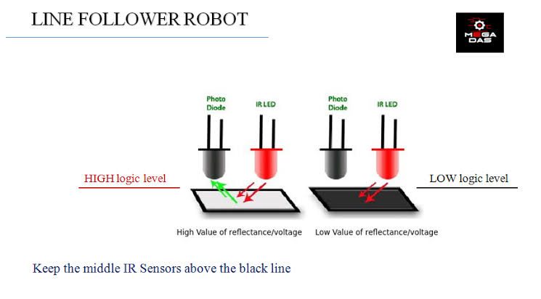
IR Sensors :
White – reflects most of signals.
White – absorb less signals.
White – high logic level.
Black – absorb most of signals.
Black – reflects less signal (radiation)
Black – low logic level.

Slide 8
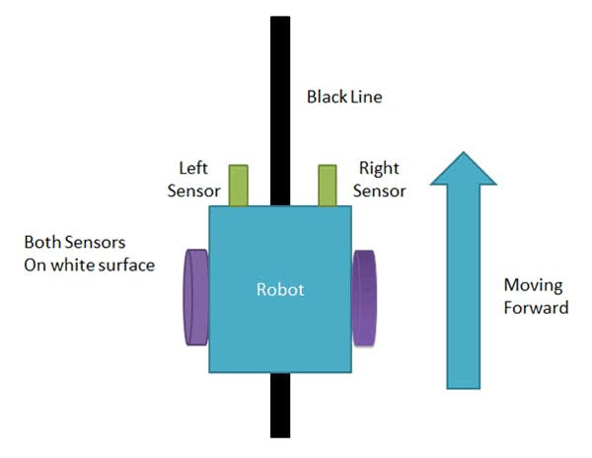
MOVEMENTS FUNCTIONING SPECIFICATION :
When both sensors get same reflected signals (high logic level)
Moves-forward in straight direction

Slide 9
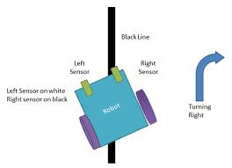
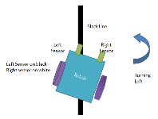
LEFT AND RIGHT MOVEMENTS : (turnings)

Slide 10
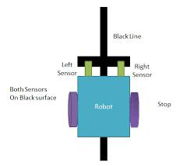
ENDING POINT OR STOPS :
Either any one of the sensor get different reflected signals(low logic signals).
Movement stops

Slide 11
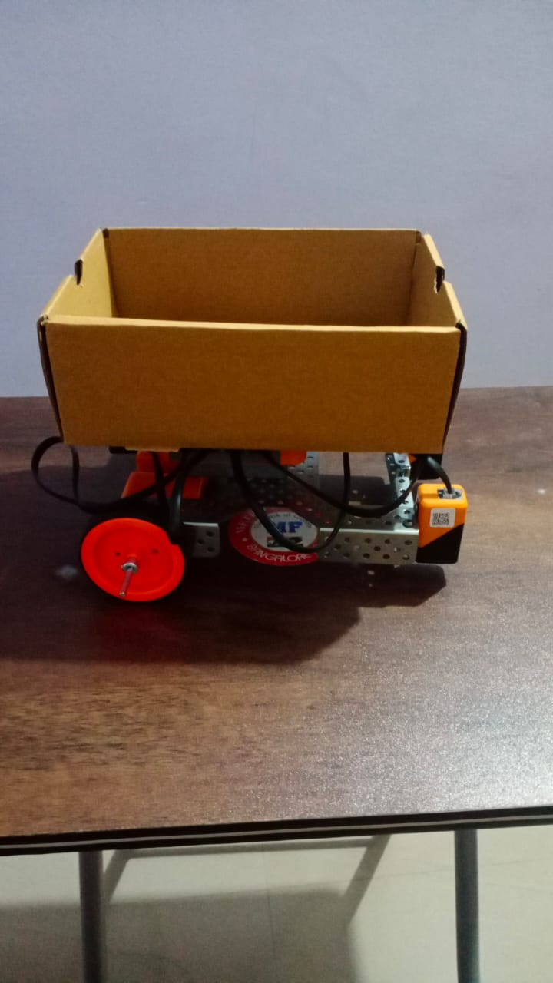
ADVANTAGES :
Cost effective
User friendly
Less maintenance
Work effectively
Fit and forget system
Long distence transport system
Heavy / large meterial shifting in short duration
Automatic and even smart phone controllable
Rechargeable

Slide 12
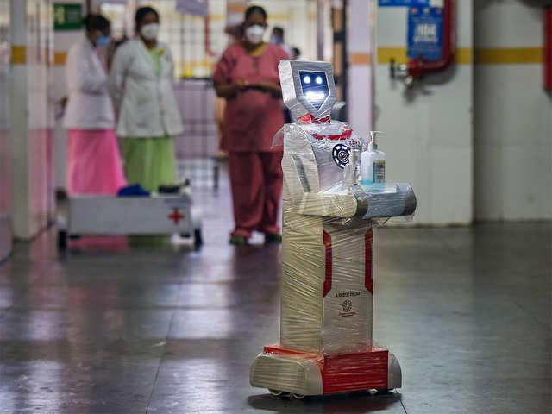
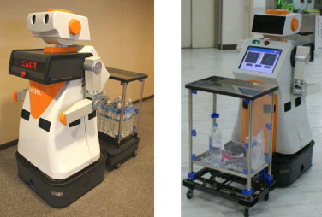
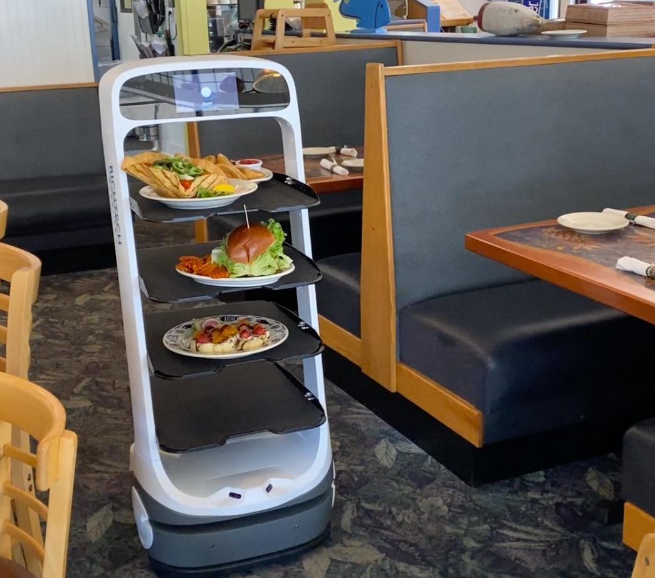
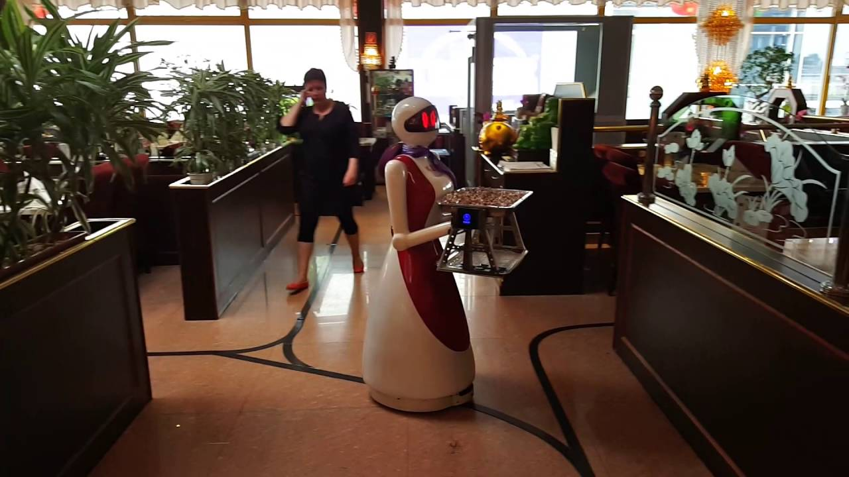
FUTURE SCOPES AND APPLICATIONS :
Medical applications
Restaurant applications

Slide 13

